Slide 1
CAP Theorem
CSE 40822-Cloud Computing-Fall 2014
Prof. Dong Wang

Slide 2

CAP Theorem
Conjectured by Prof. Eric Brewer at PODC (Principle of Distributed Computing) 2000 keynote talk
Described the trade-offs involved in distributed system
It is impossible for a web service to provide following three guarantees at the same time:
Consistency
Availability
Partition-tolerance

Slide 3
CAP Theorem
Consistency:
All nodes should see the same data at the same time
Availability:
Node failures do not prevent survivors from continuing to operate
Partition-tolerance:
The system continues to operate despite network partitions
A distributed system can satisfy any two of these guarantees at the same time but not all three

Slide 4
CAP Theorem
C
A
P

Slide 5

CAP Theorem
A simple example:
Hotel Booking: are we double-booking the same room?
Bob
Dong

Slide 6
CAP Theorem
A simple example:
Hotel Booking: are we double-booking the same room?
Bob
Dong

Slide 7

CAP Theorem
A simple example:
Hotel Booking: are we double-booking the same room?
Bob
Dong

Slide 8

CAP Theorem: Proof
2002: Proven by research conducted by Nancy Lynch and Seth Gilbert at MIT
Gilbert, Seth, and Nancy Lynch. "Brewer's conjecture and the feasibility of consistent, available, partition-tolerant web services." ACM SIGACT News 33.2 (2002): 51-59.

Slide 9
CAP Theorem: Proof
A simple proof using two nodes:
A
B

Slide 10
CAP Theorem: Proof
A simple proof using two nodes:
Not Consistent!
A
B
Respond to client

Slide 11

CAP Theorem: Proof
A simple proof using two nodes:
Not Available!
A
B
Wait to be updated

Slide 12
CAP Theorem: Proof
A simple proof using two nodes:
Not Partition Tolerant!
A
B
A gets updated from B

Slide 13
Why this is important?
The future of databases is distributed (Big Data Trend, etc.)
CAP theorem describes the trade-offs involved in distributed systems
A proper understanding of CAP theorem is essential to making decisions about the future of distributed database design
Misunderstanding can lead to erroneous or inappropriate design choices

Slide 14
Problem for Relational Database to Scale
The Relational Database is built on the principle of ACID (Atomicity, Consistency, Isolation, Durability)
It implies that a truly distributed relational database should have availability, consistency and partition tolerance.
Which unfortunately is impossible …

Slide 15
Revisit CAP Theorem
Of the following three guarantees potentially offered a by distributed systems:
Consistency
Availability
Partition tolerance
Pick two
This suggests there are three kinds of distributed systems:
CP
AP
CA
C
A
P
Any problems?

Slide 16
A popular misconception: 2 out 3
How about CA?
Can a distributed system (with unreliable network) really be not tolerant of partitions?
C
A

Slide 17

A few witnesses
Coda Hale, Yammer software engineer:
“Of the CAP theorem’s Consistency, Availability, and Partition Tolerance, Partition Tolerance is mandatory in distributed systems. You cannot not choose it.”
http://codahale.com/you-cant-sacrifice-partition-tolerance/

Slide 18

A few witnesses
Werner Vogels, Amazon CTO
“An important observation is that in larger distributed-scale systems, network partitions are a given; therefore, consistency and availability cannot be achieved at the same time.”
http://www.allthingsdistributed.com/2008/12/eventually_consistent.html

Slide 19

A few witnesses
Daneil Abadi, Co-founder of Hadapt
So in reality, there are only two types of systems ... I.e., if there is a partition, does the system give up availability or consistency?
http://dbmsmusings.blogspot.com/2010/04/problems-with-cap-and-yahoos-little.html

Slide 20
CAP Theorem 12 year later
Prof. Eric Brewer: father of CAP theorem
“The “2 of 3” formulation was always misleading because it tended to oversimplify the tensions among properties. ...
CAP prohibits only a tiny part of the design space: perfect availability and consistency in the presence of partitions, which are rare.”
http://www.infoq.com/articles/cap-twelve-years-later-how-the-rules-have-changed

Slide 21
Consistency or Availability
Consistency and Availability is not “binary” decision
AP systems relax consistency in favor of availability – but are not inconsistent
CP systems sacrifice availability for consistency- but are not unavailable
This suggests both AP and CP systems can offer a degree of consistency, and availability, as well as partition tolerance
C
A
P

Slide 22
AP: Best Effort Consistency
Example:
Web Caching
DNS
Trait:
Optimistic
Expiration/Time-to-live
Conflict resolution

Slide 23
CP: Best Effort Availability
Example:
Majority protocols
Distributed Locking (Google Chubby Lock service)
Trait:
Pessimistic locking
Make minority partition unavailable

Slide 24
Types of Consistency
Strong Consistency
After the update completes, any subsequent access will return the same updated value.
Weak Consistency
It is not guaranteed that subsequent accesses will return the updated value.
Eventual Consistency
Specific form of weak consistency
It is guaranteed that if no new updates are made to object, eventually all accesses will return the last updated value (e.g., propagate updates to replicas in a lazy fashion)

Slide 25
Eventual Consistency Variations
Causal consistency
Processes that have causal relationship will see consistent data
Read-your-write consistency
A process always accesses the data item after it’s update operation and never sees an older value
Session consistency
As long as session exists, system guarantees read-your-write consistency
Guarantees do not overlap sessions

Slide 26
Eventual Consistency Variations
Monotonic read consistency
If a process has seen a particular value of data item, any subsequent processes will never return any previous values
Monotonic write consistency
The system guarantees to serialize the writes by the same process
In practice
A number of these properties can be combined
Monotonic reads and read-your-writes are most desirable

Slide 27



Eventual Consistency - A Facebook Example
Bob finds an interesting story and shares with Alice by posting on her Facebook wall
Bob asks Alice to check it out
Alice logs in her account, checks her Facebook wall but finds:
- Nothing is there!
?

Slide 28

Eventual Consistency - A Facebook Example
Bob tells Alice to wait a bit and check out later
Alice waits for a minute or so and checks back:
- She finds the story Bob shared with her!

Slide 29
Eventual Consistency - A Facebook Example
Reason: it is possible because Facebook uses an eventual consistent model
Why Facebook chooses eventual consistent model over the strong consistent one?
Facebook has more than 1 billion active users
It is non-trivial to efficiently and reliably store the huge amount of data generated at any given time
Eventual consistent model offers the option to reduce the load and improve availability

Slide 30



Eventual Consistency - A Dropbox Example
Dropbox enabled immediate consistency via synchronization in many cases.
However, what happens in case of a network partition?

Slide 31
Eventual Consistency - A Dropbox Example
Let’s do a simple experiment here:
Open a file in your drop box
Disable your network connection (e.g., WiFi, 4G)
Try to edit the file in the drop box: can you do that?
Re-enable your network connection: what happens to your dropbox folder?

Slide 32
Eventual Consistency - A Dropbox Example
Dropbox embraces eventual consistency:
Immediate consistency is impossible in case of a network partition
Users will feel bad if their word documents freeze each time they hit Ctrl+S , simply due to the large latency to update all devices across WAN
Dropbox is oriented to personal syncing, not on collaboration, so it is not a real limitation.

Slide 33
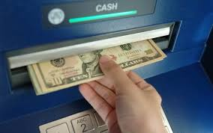
Eventual Consistency - An ATM Example
In design of automated teller machine (ATM):
Strong consistency appear to be a nature choice
However, in practice, A beats C
Higher availability means higher revenue
ATM will allow you to withdraw money even if the machine is partitioned from the network
However, it puts a limit on the amount of withdraw (e.g., $200)
The bank might also charge you a fee when a overdraft happens

Slide 34
Dynamic Tradeoff between C and A
An airline reservation system:
When most of seats are available: it is ok to rely on somewhat out-of-date data, availability is more critical
When the plane is close to be filled: it needs more accurate data to ensure the plane is not overbooked, consistency is more critical
Neither strong consistency nor guaranteed availability, but it may significantly increase the tolerance of network disruption

Slide 35
Heterogeneity: Segmenting C and A
No single uniform requirement
Some aspects require strong consistency
Others require high availability
Segment the system into different components
Each provides different types of guarantees
Overall guarantees neither consistency nor availability
Each part of the service gets exactly what it needs
Can be partitioned along different dimensions

Slide 36
Discussion
In an e-commercial system (e.g., Amazon, e-Bay, etc), what are the trade-offs between consistency and availability you can think of? What is your strategy?
Hint -> Things you might want to consider:
Different types of data (e.g., shopping cart, billing, product, etc.)
Different types of operations (e.g., query, purchase, etc.)
Different types of services (e.g., distributed lock, DNS, etc.)
Different groups of users (e.g., users in different geographic areas, etc.)

Slide 37
Partitioning Examples
Data Partitioning
Operational Partitioning
Functional Partitioning
User Partitioning
Hierarchical Partitioning

Slide 38
Partitioning Examples
Data Partitioning
Different data may require different consistency and availability
Example:
Shopping cart: high availability, responsive, can sometimes suffer anomalies
Product information need to be available, slight variation in inventory is sufferable
Checkout, billing, shipping records must be consistent

Slide 39
Partitioning Examples
Operational Partitioning
Each operation may require different balance between consistency and availability
Example:
Reads: high availability; e.g.., “query”
Writes: high consistency, lock when writing; e.g., “purchase”

Slide 40
Partitioning Examples
Functional Partitioning
System consists of sub-services
Different sub-services provide different balances
Example: A comprehensive distributed system
Distributed lock service (e.g., Chubby) :
Strong consistency
DNS service:
High availability

Slide 41
Partitioning Examples
User Partitioning
Try to keep related data close together to assure better performance
Example: Craglist
Might want to divide its service into several data centers, e.g., east coast and west coast
Users get high performance (e.g., high availability and good consistency) if they query servers closet to them
Poorer performance if a New York user query Craglist in San Francisco

Slide 42
Partitioning Examples
Hierarchical Partitioning
Large global service with local “extensions”
Different location in hierarchy may use different consistency
Example:
Local servers (better connected) guarantee more consistency and availability
Global servers has more partition and relax one of the requirement

Slide 43
What if there are no partitions?
Tradeoff between Consistency and Latency:
Caused by the possibility of failure in distributed systems
High availability -> replicate data -> consistency problem
Basic idea:
Availability and latency are arguably the same thing: unavailable -> extreme high latency
Achieving different levels of consistency/availability takes different amount of time

Slide 44
CAP -> PACELC
A more complete description of the space of potential tradeoffs for distributed system:
If there is a partition (P), how does the system trade off availability and consistency (A and C); else (E), when the system is running normally in the absence of partitions, how does the system trade off latency (L) and consistency (C)?
Abadi, Daniel J. "Consistency tradeoffs in modern distributed database system design." Computer-IEEE Computer Magazine 45.2 (2012): 37.

Slide 45
PACELC
C
A
C
L
Normal
Partitioned

Slide 46
Examples
PA/EL Systems: Give up both Cs for availability and lower latency
Dynamo, Cassandra, Riak
PC/EC Systems: Refuse to give up consistency and pay the cost of availability and latency
BigTable, Hbase, VoltDB/H-Store
PA/EC Systems: Give up consistency when a partition happens and keep consistency in normal operations
MongoDB
PC/EL System: Keep consistency if a partition occurs but gives up consistency for latency in normal operations
Yahoo! PNUTS

Slide 47
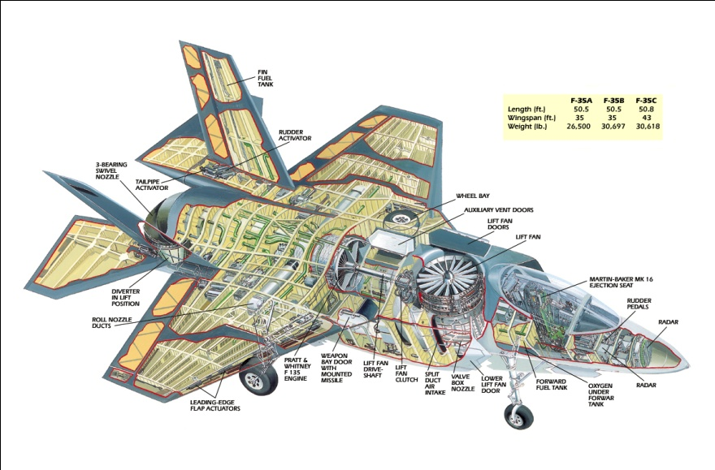


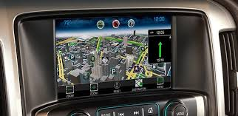


CSE 40437/60437, Spring 2015:
Social Sensing & Cyber-Physical Systems
Zero-Energy Buildings
Embedded Computing Systems
Cyber
Physical
Systems
Social Sensing
Green Navigation Systems
Body Area Networks
Smart Grids
Contact: Prof. Dong Wang: dwang5@nd.edu
http://www3.nd.edu/~dwang5/teach/spring15/spring15_wang_flyer.pdf

Slide 48
CSE 40437/60437, Spring 2015:
Social Sensing & Cyber-Physical Systems
Zero-Energy Buildings
Energy
Time
Embedded Computing Systems
Cyber
Physical
Systems
Social Sensing
Data
Social
Green Navigation Systems
Body Area Networks
Smart Grids
Contact: Prof. Dong Wang: dwang5@nd.edu
http://www3.nd.edu/~dwang5/teach/spring15/spring15_wang_flyer.pdf

Slide 49
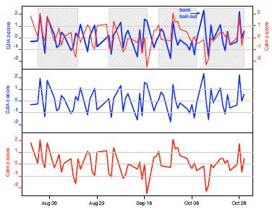

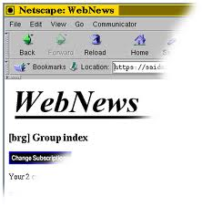

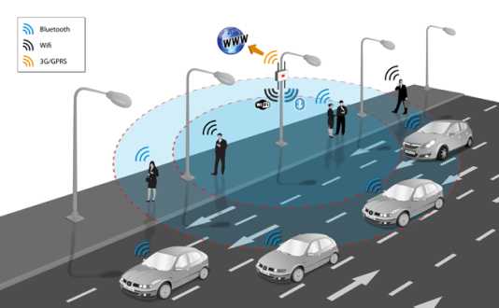

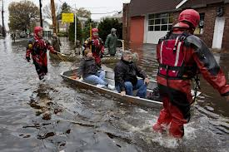






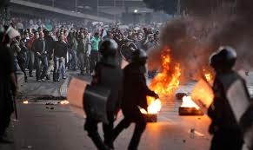



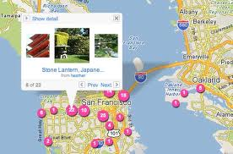
CSE 40437/60437, Spring 2015:
Social Sensing & Cyber-Physical Systems
Events
Stock Prediction (Money)
Applications
Analytics
News and Public Sources
Boston Bombing
Decision
Support
Traffic Monitoring (Time)
Hurricane Sandy
People
Disaster Response (Lives)
Data
Egypt unrest
Sensors
Contact: Prof. Dong Wang: dwang5@nd.edu
http://www3.nd.edu/~dwang5/teach/spring15/spring15_wang_flyer.pdf
Geo Tagging (Smart City)

Slide 50
Thank you!

